Slide 1
Revitalizing DFI Retail Group's Supermarket Performance in Singapore
BUAN-665-DO

Slide 2
Authors
Mukesh Nanabala Ramakrishna (0962819)
Harshitha Florence Sampara (0966698)
Sai Vaishnavi Gaddi (0964981)

Slide 3
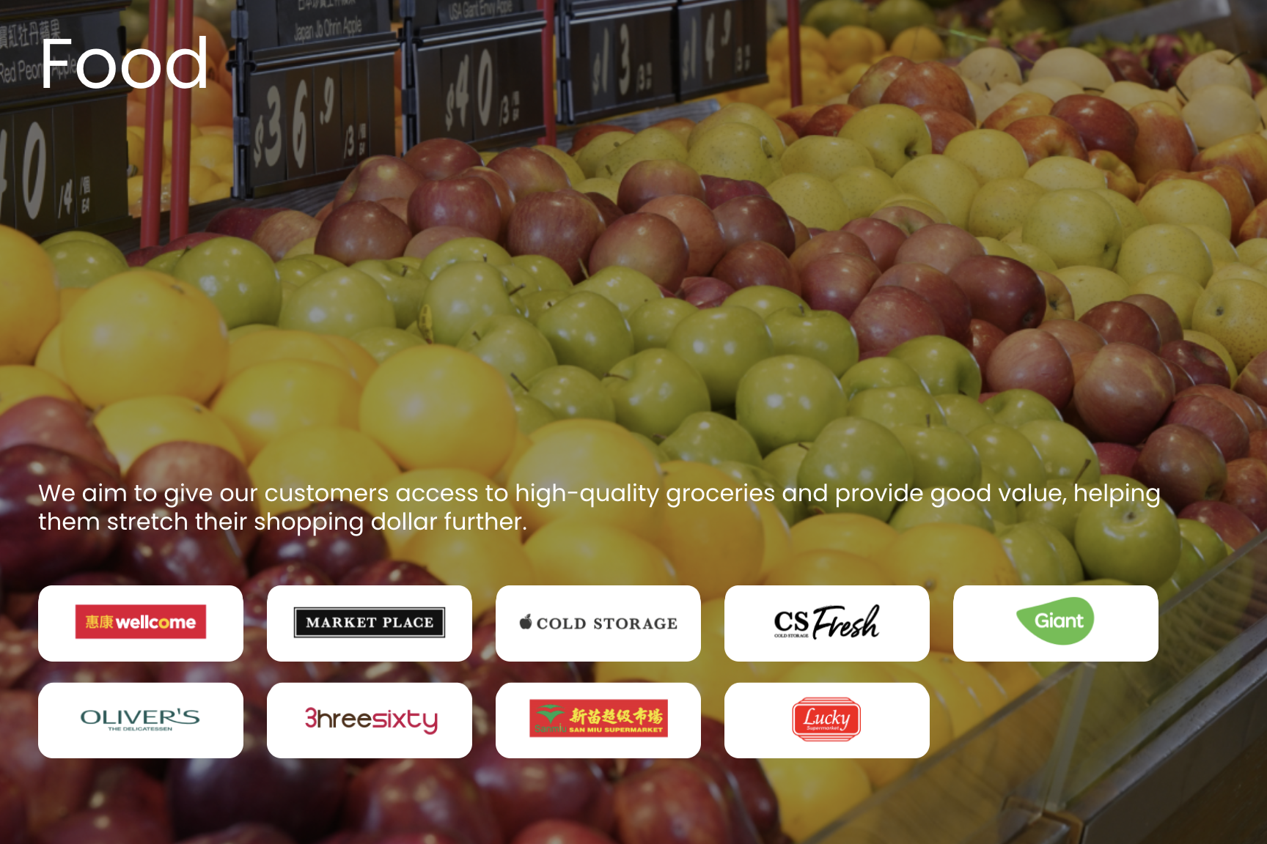
Introduction
In Singapore's dynamic retail landscape, staying ahead requires more than just stocking shelves. DFI Retail Group's Supermarkets and Hypermarkets division faces the challenge of declining sales, demanding a fresh, data-driven approach.
DFI Retail Group (formerly Dairy Farm Group) is a leading pan-Asian retailer, operating approximately 11,000 outlets and employing 200,000 people across the region. With a diverse portfolio including Cold Storage, CS Fresh, and Giant, DFI is a key player in Singapore's retail sector.

Slide 4
CASE STUDY OBJECTIVE
1. Analyze customer demographics and geographical distribution for each of DFI's brands.
2. Identify and assess DFI's competitors, including their market share, store locations, and customer profiles.
3. Evaluate the alignment between DFI's store locations and customer residences.
4. Determine if DFI should expand its presence in the northern region of Singapore.
5. Develop data-driven strategies to revitalize DFI's supermarket performance and boost sales in Singapore.
6. Explore opportunities to leverage digital sales growth and enhance customer experience.
7. Address challenges related to cost inflation and changing consumer sentiment, particularly in the Southeast Asian Grocery Retail business.

Slide 5
DATASETS/RESOURCES
CSISG 2017 Supermarket Incidence Data
Contains raw customer incidence data, capturing supermarket visit patterns and brand preferences.
Provides insights into customer demographics and purchasing behavior.
Postal Code Database
Includes geographic coordinates (latitude and longitude) for postal codes referenced in the incidence data.
Enables geospatial mapping of customer locations and store accessibility analysis.
Store Locations Dataset
Contains the geographical locations of Dairy Farm Group supermarkets and Sheng Siong stores.
Facilitates competitor analysis and store distribution evaluation.
Gross Monthly Income Distribution Dataset
Represents the percentage distribution of gross monthly income across different cities.

Slide 6
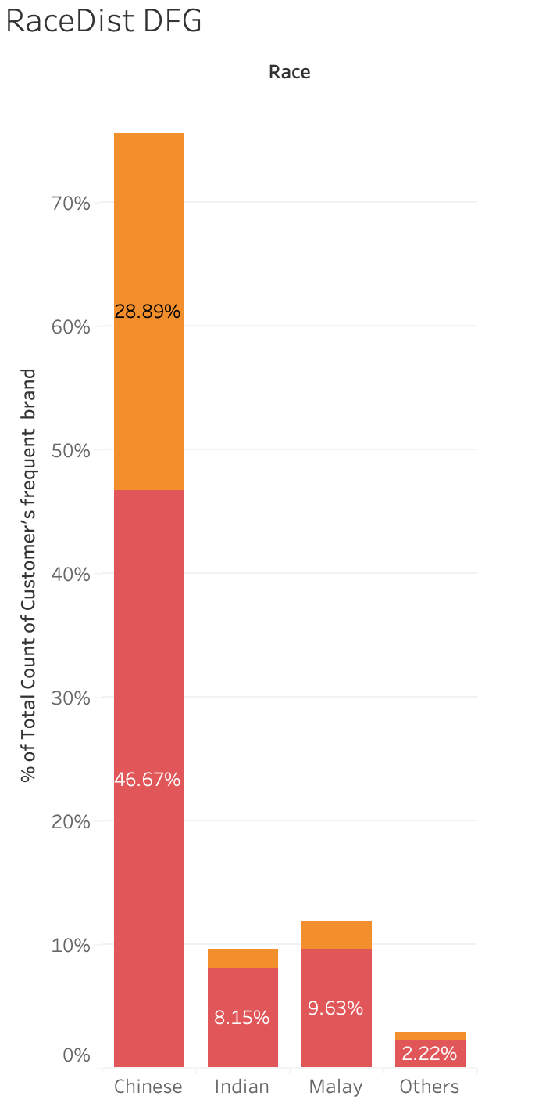
DFI’s Customer Profile - Race
The predominant race among Dairy Farm Group (DFG) customers varies across its two supermarket brands:
Cold Storage and Giant both have a majority of Chinese customers, with 28.89% and 46.67%, respectively.
Giant has a significantly higher proportion of Malay (9.63%) and Indian (8.15%) customers compared to Cold Storage.
However, this racial distribution should be interpreted in context:
The overall survey sample included 74% Chinese respondents across all supermarket brands, which may influence the numbers.
To gain a clearer picture of brand preference, it would be useful to compare these percentages against the total racial composition of all supermarket customers.
This suggests that while Giant attracts a more diverse customer base than Cold Storage, the larger share of Chinese customers could partly be due to their higher representation in the overall survey data rather than a direct brand preference.

Slide 7
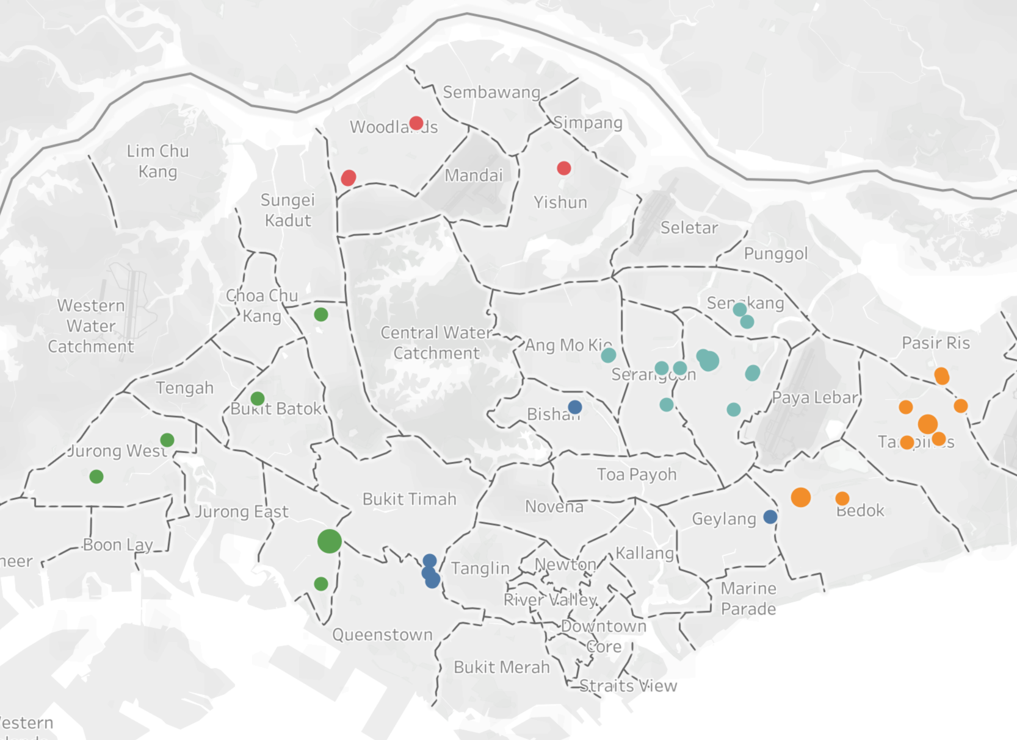
Cold Storage - Customer Area by Region
Cold Storage Customers by Region
North-East (NE) Region: 15 customers (Highest concentration)
East Region: 11 customers
West Region: 9 customers
Central Region: 6 customers
North Region: 4 customers (Lowest concentration)
Key Insights:
The North-East (15) and East (11) regions have the highest number of Cold Storage customers, suggesting a strong market presence.
The West region (9) has more customers than initially noted, indicating moderate demand.
The North region (4) has the lowest customer count, potentially highlighting an opportunity for expansion.

Slide 8
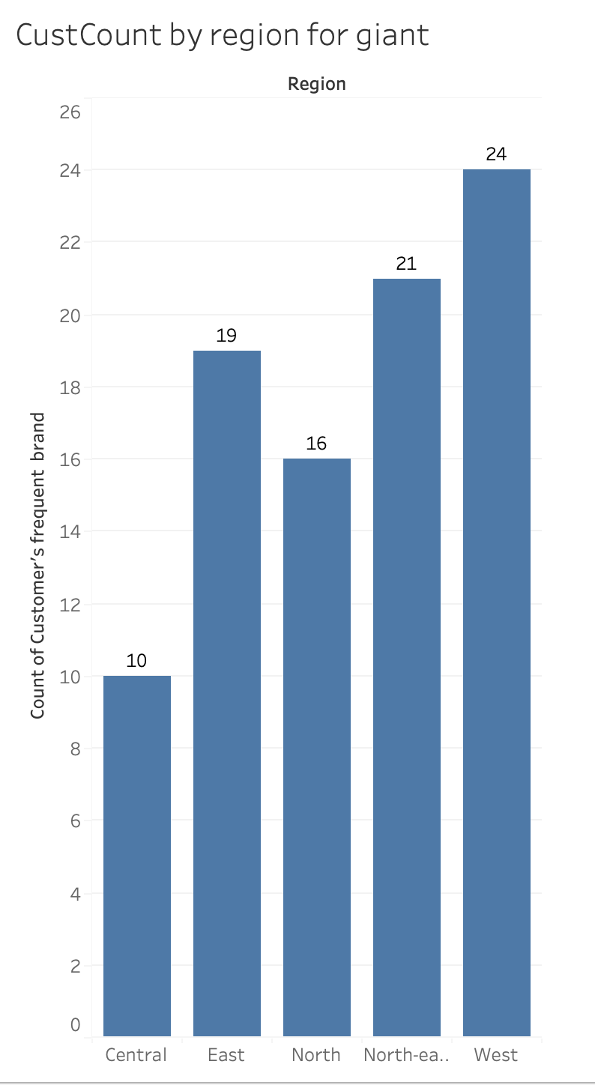
Giant - Customer Area by Region
Regional Distribution of Giant Customers
West Region: 24 customers (Highest concentration)
North-East (NE) Region: 21 customers
East Region: 19 customers
North Region: 16 customers
Central Region: 10 customers (Lowest concentration)
Comparison: Cold Storage vs. Giant
Giant has a higher customer count in every region compared to Cold Storage.
West, North-East, and East are key strongholds for Giant.
West (24) and North-East (21) have the highest number of customers, which could indicate higher store density or stronger brand preference in these regions.
Cold Storage is significantly weaker in the North and West.
Giant has 24 in the West vs. Cold Storage’s 9 → Indicates that Giant dominates this area.

Slide 9
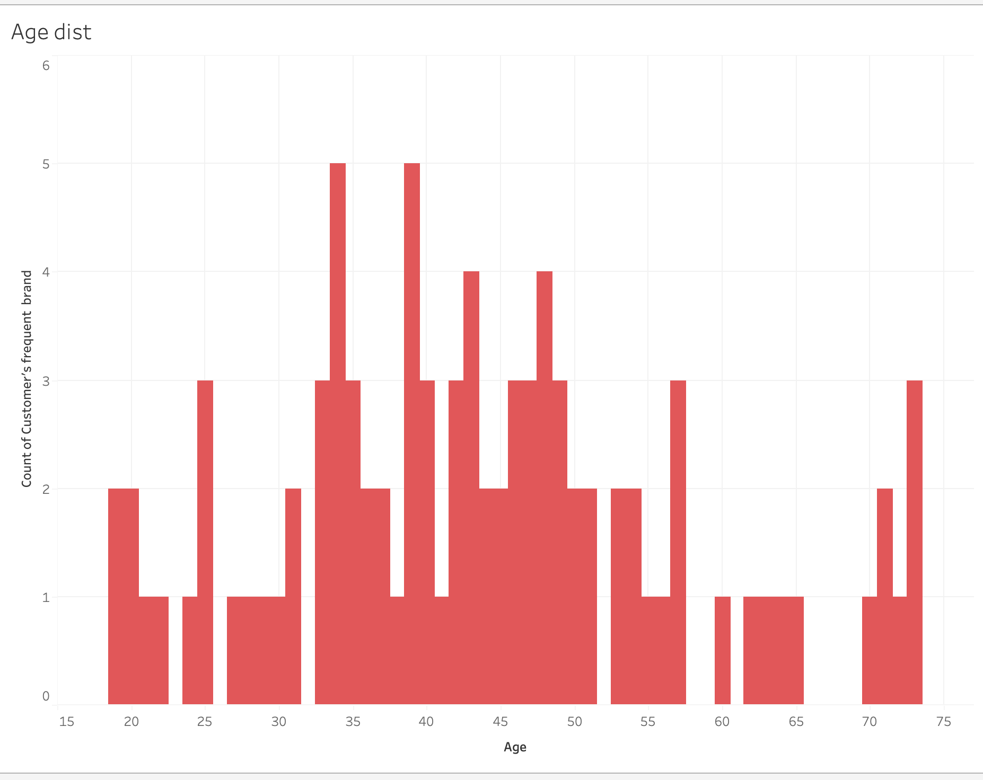
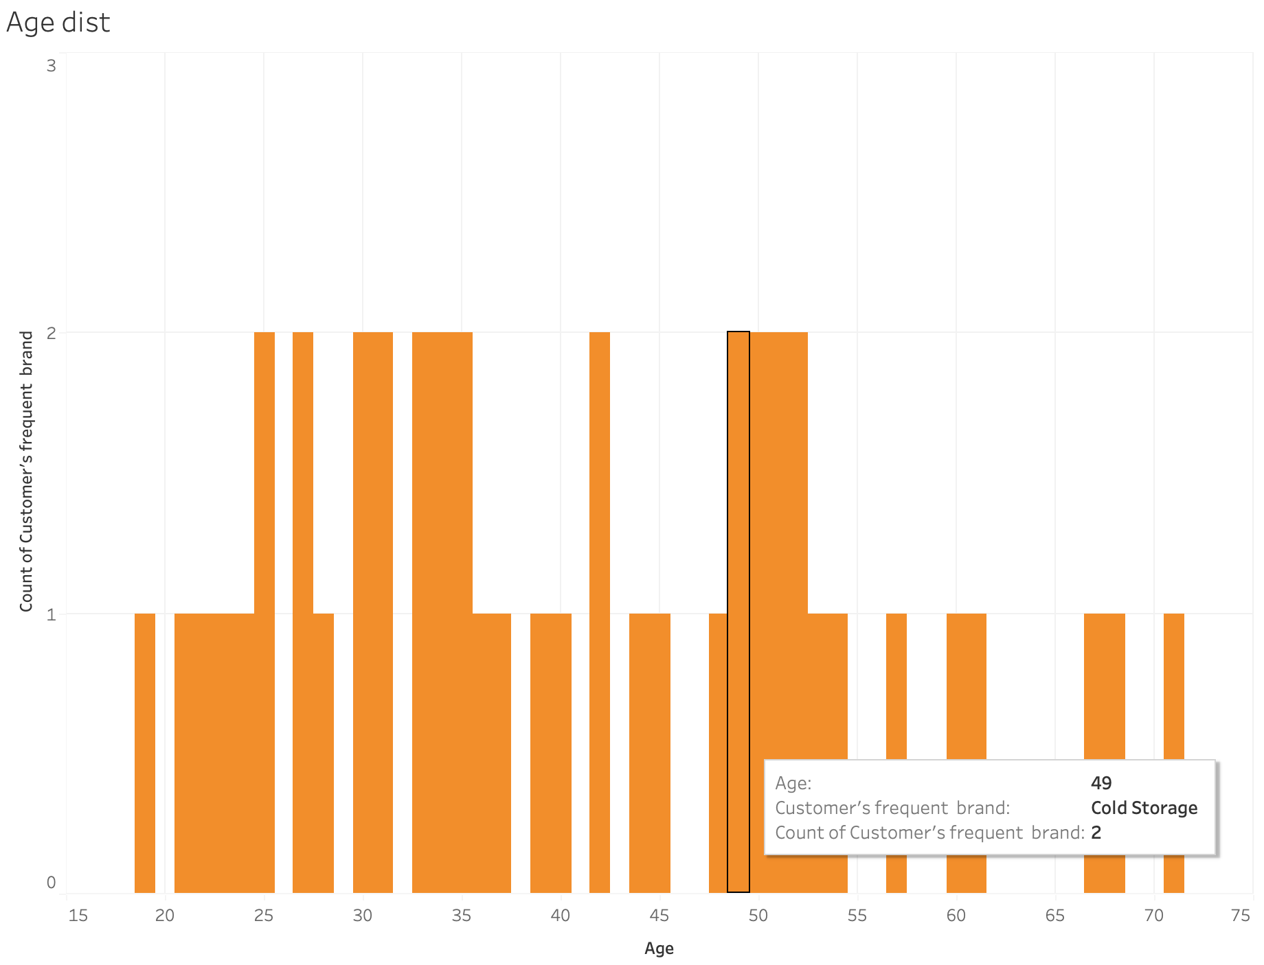
Age Distribution - Giant Vs Cold Storage
Age Distribution of Cold Storage vs. Giant Customers
Both Cold Storage and Giant have a starting customer age of 19.
Cold Storage customers range from 19 to 71 years old.
Giant customers have a slightly wider range, from 19 to 73 years old.
Key Insights:
Giant has a slightly broader age range, attracting older customers up to 73 years, while Cold Storage stops at 71 years.
This two-year difference could indicate that Giant appeals more to elderly customers, possibly due to pricing, promotions, or product variety.
If Dairy Farm Group wants to expand Cold Storage’s reach, they might consider strategies like senior-friendly promotions, product offerings, or store accessibility improvements to attract older shoppers.
Giant
Cold Storage

Slide 10
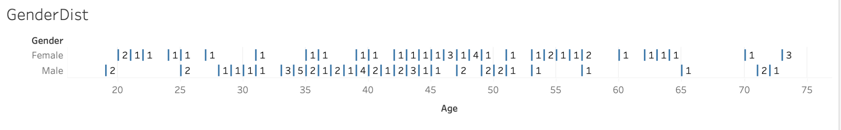
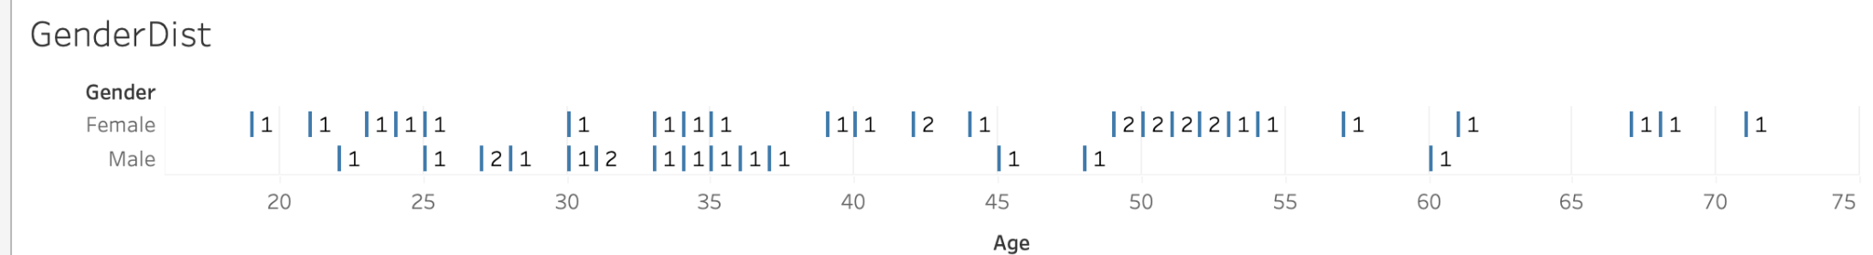
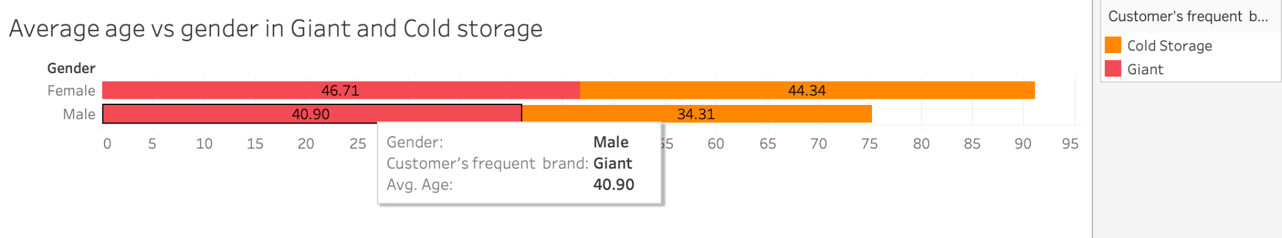
Age Distribution vs Gender
Giant
Cold Storage
For Giant, the predominant age groups are 33–46 for males (average 40.90) and 42–50 for females (average 46.71), while for Cold Storage they are 33–37 for males (average 34.31) and 49–54 for females (average 44.34). This shows that in both brands, female customers tend to be older than male customers, though overall, Cold Storage attracts a younger customer base compared to Giant.

Slide 11
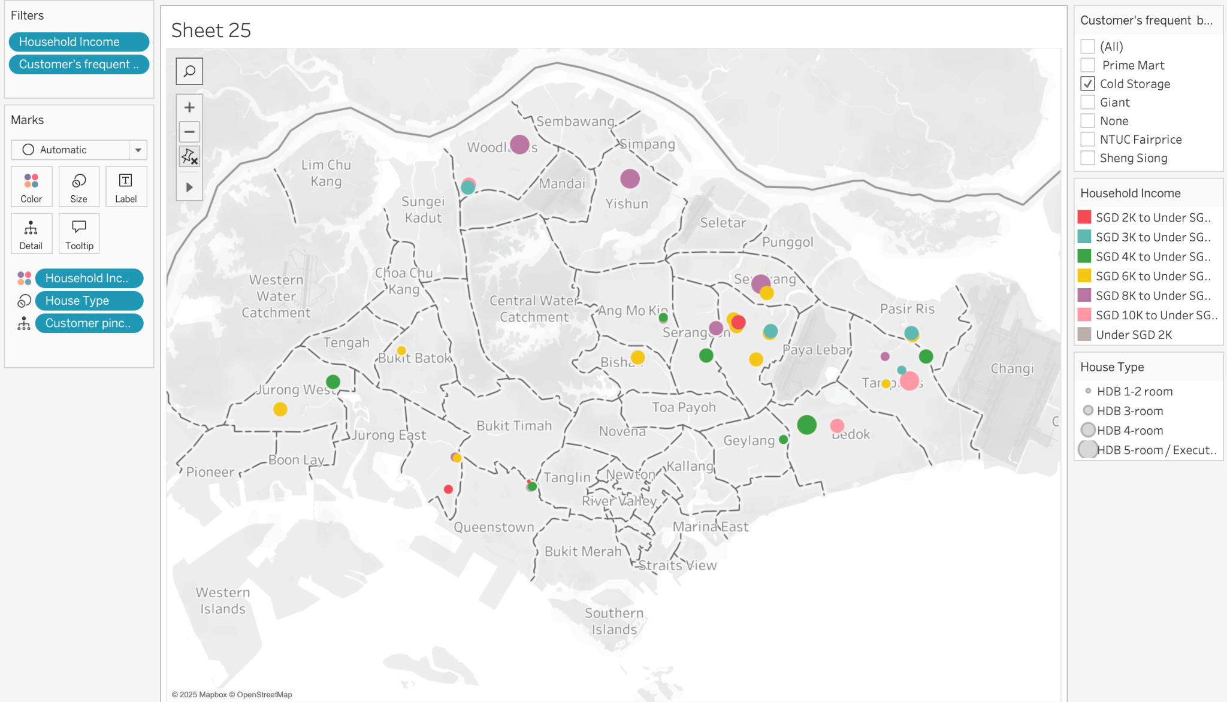
Customer Profile - Cold Storage
Housing: The majority of customers, with the exception of one, own a minimum of a 3-room house. This suggests a customer base with a stable living situation and likely a middle-class demographic. Homeownership, especially with 3-room houses, is typically associated with a certain level of financial security.
Income: The most common income range is between SGD 6,000 and 8,000, indicating that the majority of customers fall within the middle-income group. This aligns with the demographic that typically shops at both Cold Storage and Giant, as they often prioritize quality, but may be mindful of pricing.
Income Distribution: No customers earn above SGD 20,000, which suggests that the customer base does not include high-income earners or individuals with luxury spending power. This supports the idea that both brands cater more to middle to upper-middle-class consume

Slide 12
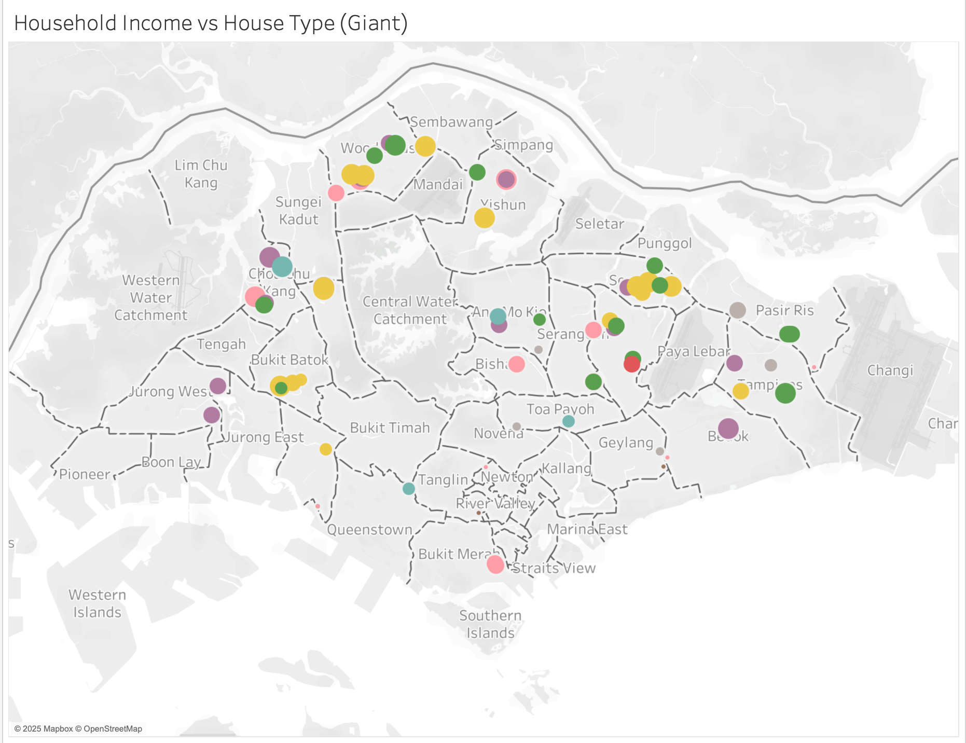
Customer Profile - Giant
Income: The most common income range is between SGD 4,000 and 10,000, indicating that the majority of customers fall within the middle-income group. This aligns with the demographic that typically shops at both Cold Storage and Giant, as they often prioritize quality, but may be mindful of pricing.
Income Distribution: No customers earn above SGD 20,000, which suggests that the customer base does not include high-income earners or individuals with luxury spending power. This supports the idea that both brands cater more to middle to upper-middle-class consume

Slide 13
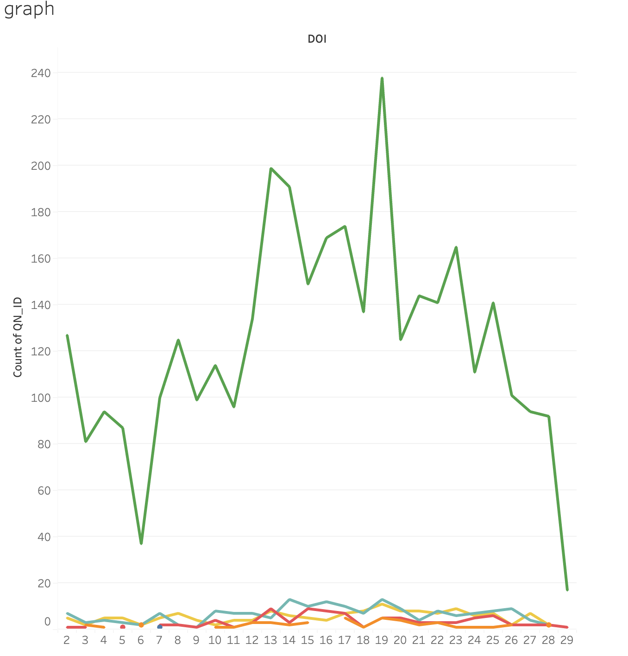
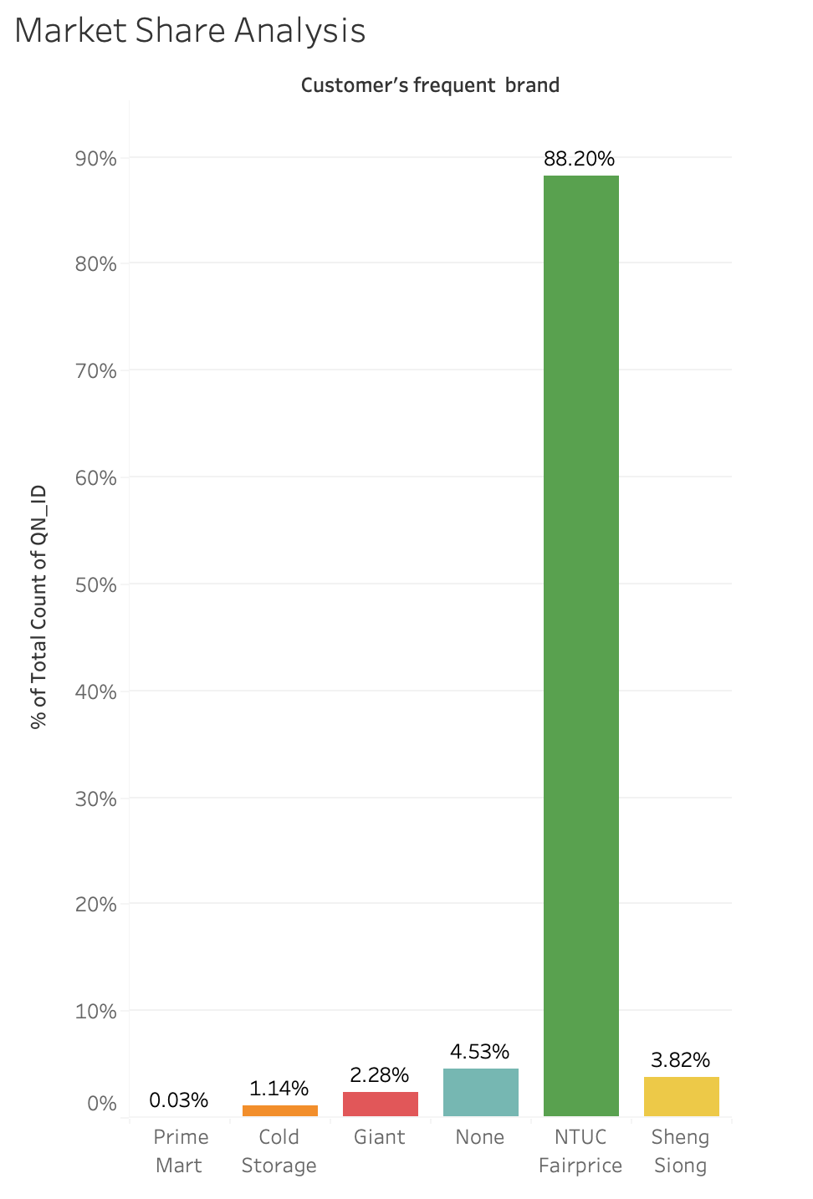
COMPETITOR ANALYSIS
The dataset includes six supermarket variables: Prime Mart, Cold Storage, Giant, None, NTUC FairPrice, and Sheng Siong. Among these, only Cold Storage and Giant belong to Dairy Farm Group (DFI), while NTUC FairPrice and Sheng Siong are competitors.
The market share distribution shows NTUC FairPrice dominating with 88.20%, followed by Sheng Siong (3.82%), "None" (4.53%), Giant (2.28%), Cold Storage (1.14%), and Prime Mart (0.03%). We will be ignoring “None” and “Prime Mart” for now.
This suggests two possible interpretations:
A Skewed Dataset – The overwhelming dominance of NTUC FairPrice could indicate an imbalance in sampling, meaning the dataset may not be fully representative of the entire market.
Market Reality – Alternatively, NTUC FairPrice may genuinely be the most popular supermarket, holding a near-monopoly in Singapore’s grocery sector.
Strategic Implication for DFI
Since NTUC FairPrice is the clear market leader, Dairy Farm Group should target the 6k–8k income segment and focus on differentiation strategies (e.g., premium offerings for Cold Storage or affordability for Giant) to compete effectively

Slide 14
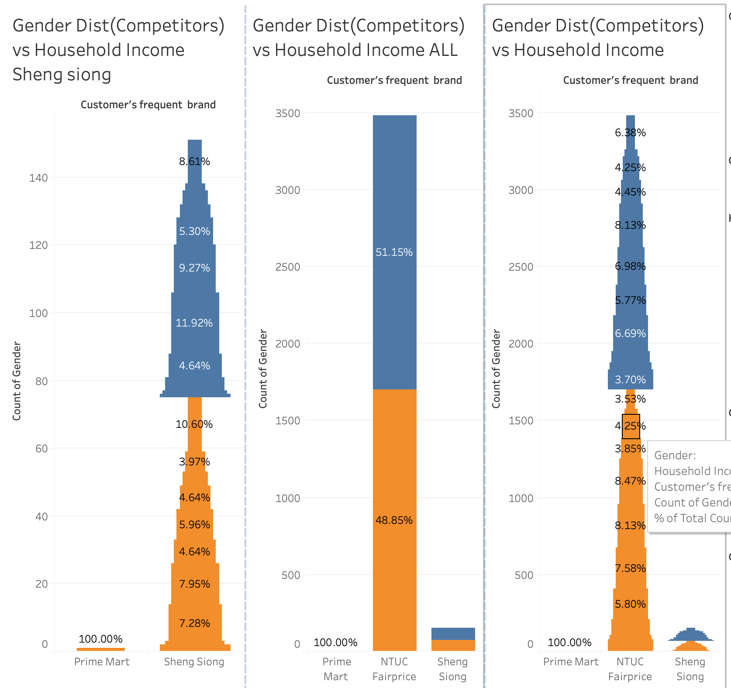
Gender vs. Income Insights for Sheng Siong and NTUC Fairprice
Sheng Siong
Male customers: Primarily concentrated in the SGD 8k–15k range, with a minimum percentage of 7.28% in the 10k–15k bracket.
Female customers: More concentrated in the SGD 6k–10k range, with a minimum percentage of 9.27% in the 6k–8k bracket.
A notable 10.60% of male respondents selected "Do Not Know" for income, which may indicate uncertainty or non-disclosure.
NTUC FairPrice
Female customers are primarily concentrated between SGD 4k–8k, with each segment accounting for approximately 7% of the total female customer base.
The overall female income distribution is spread out, with the minimum percentage being 8%.
Male customers are mostly concentrated in the SGD 4k–10k range, with 4k–8k accounting for over 8% and 8k–10k representing 7.58% of the total male population.

Slide 15
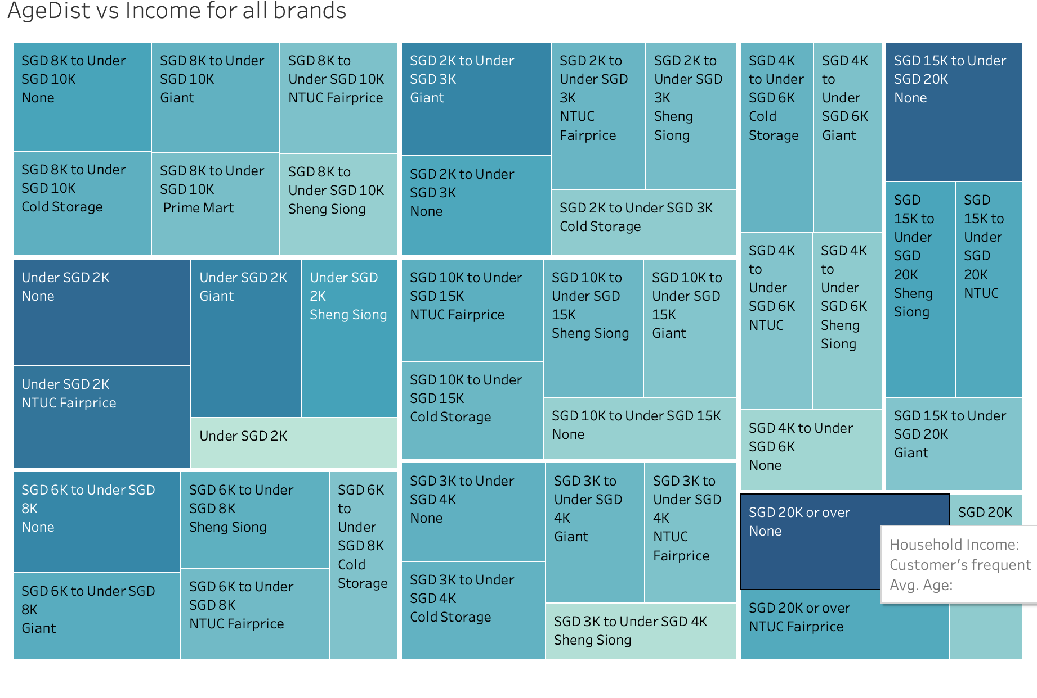
Average Age Distribution vs Income
Income vs. Age Trends
Until SGD 10k, Giant has the oldest average customer base.
After SGD 10k, NTUC FairPrice consistently has the oldest average customer base.
Cold Storage has a variable average age, indicating a different customer demographic despite being part of the same conglomerate.
After SGD 10k, both NTUC FairPrice and Sheng Siong have the oldest average age, which are close to each other.
Cold Storage remains variable throughout all income brackets.
Key Observations:
Giant attracts an older demographic in the lower income brackets, possibly due to affordability and product offerings.
NTUC FairPrice serves older customers in higher income groups, indicating a stronger presence among financially stable households.
Cold Storage's fluctuating age demographic suggests a diverse customer base with varying shopping preferences.
This insight can help in refining marketing and location strategies for targeted customer engagement.

Slide 16
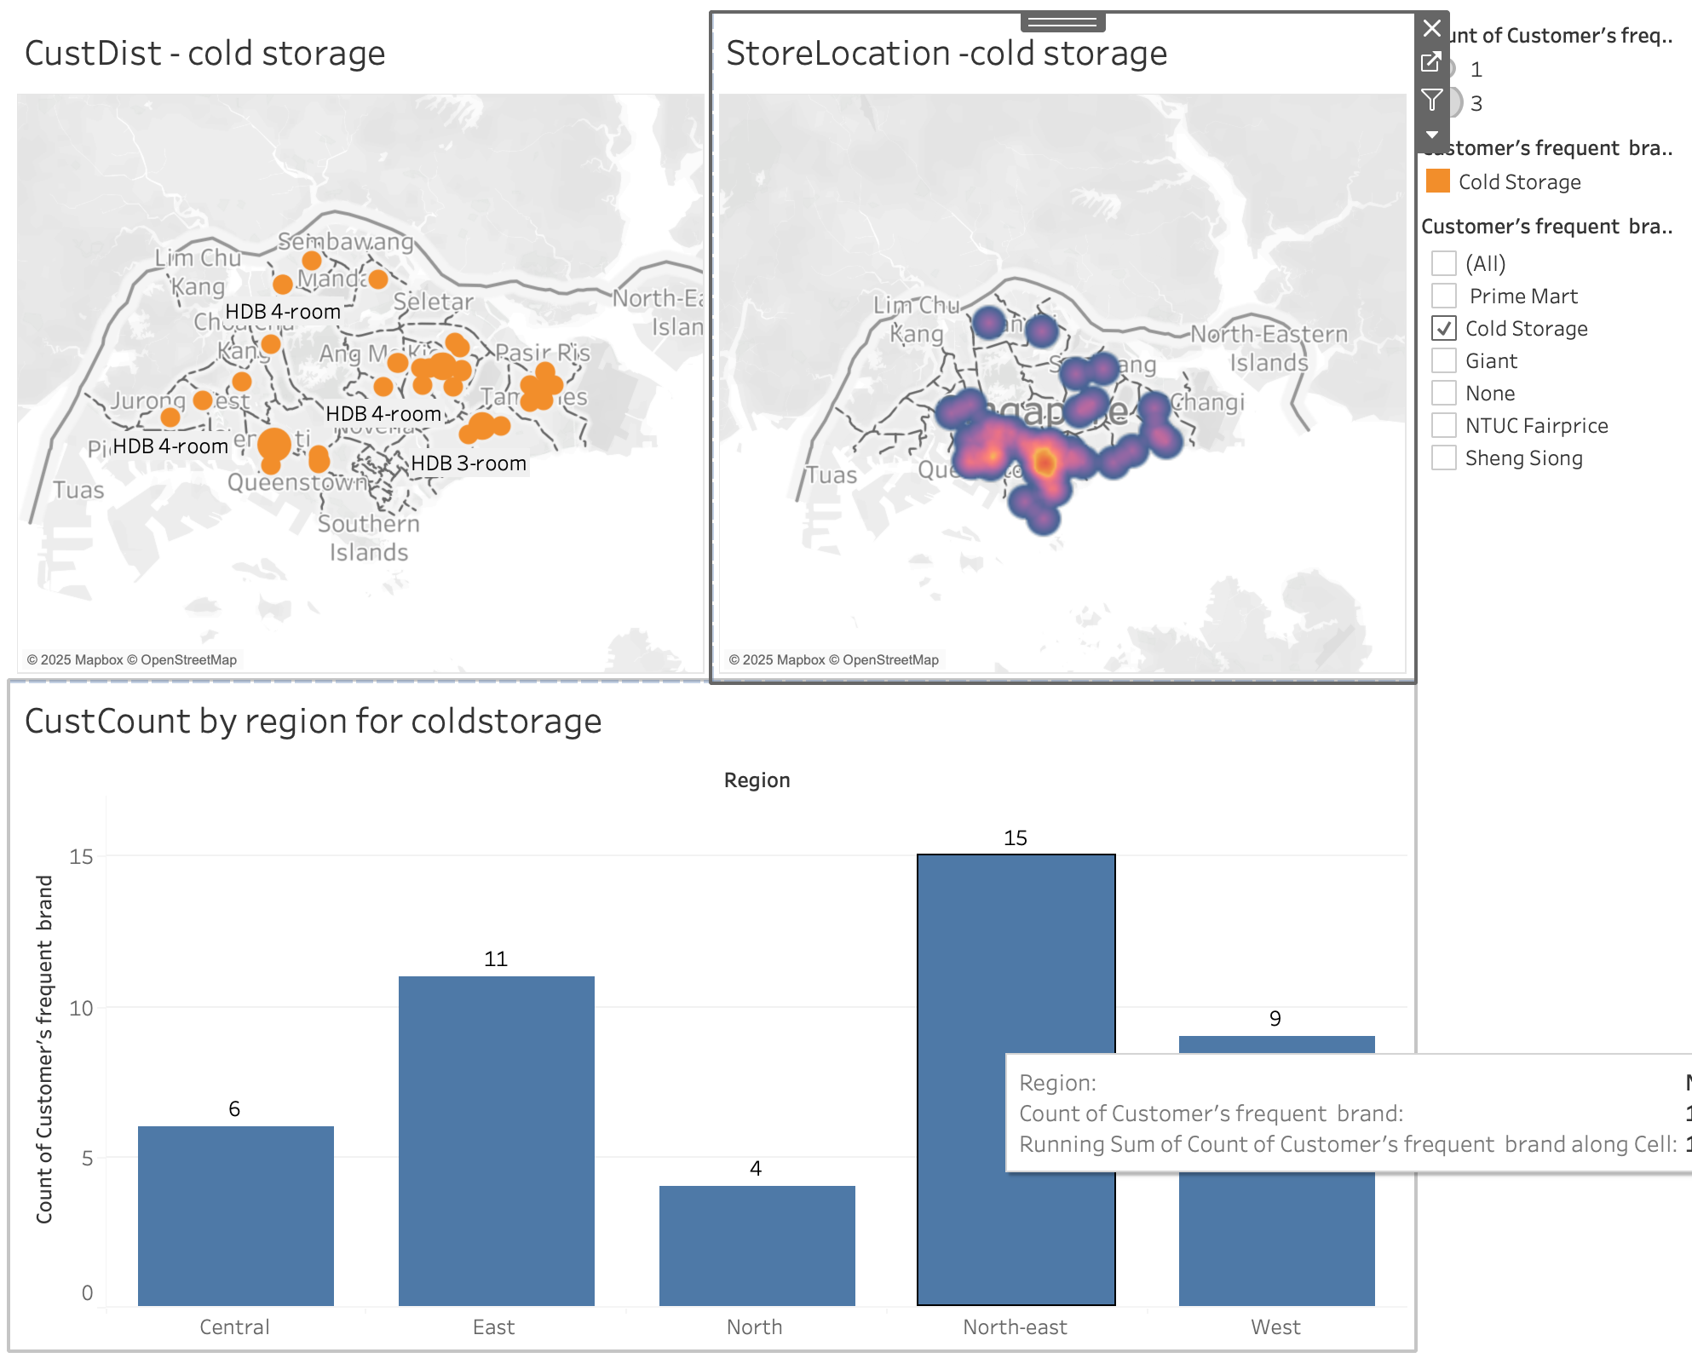
In-Depth Analysis -Cloud Storage
Cold Storage has stores in the North and West, but many customers in the West are far from store locations, which might lead them to choose other brands.
The Central region has a higher concentration of stores, but it may not align with customer demand.
The North-East and East regions have the highest customer density but very few Cold Storage stores, indicating a need for expansion.
The North region has a low customer base, which might be due to the limited number of stores rather than a lack of demand.
Despite fewer stores, the West region has a relatively strong customer base, making it a promising area for further focus and expansion.

Slide 17
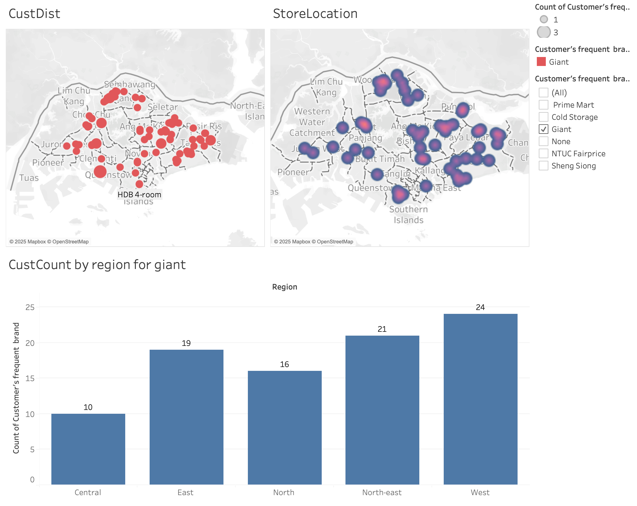
In-Depth Analysis - Giant
Incase of Giant though the highest customer base is West Region the number of stores seem to be sparser compare to East and North-East.
The lesser customer base of North and Central regions might attribute to the least number of storage.
So, focusing on retaining the customers by adding more stores in West, Central regions might help the Giant increase its customer base.
Also focusing on older customers with average age of 40 for males and 46 for females with below the income bracket of less than 10k will be best for the Giant.
Also capturing the customers who have not been captured by others by promotions and more store locations will be a game changer

Slide 18
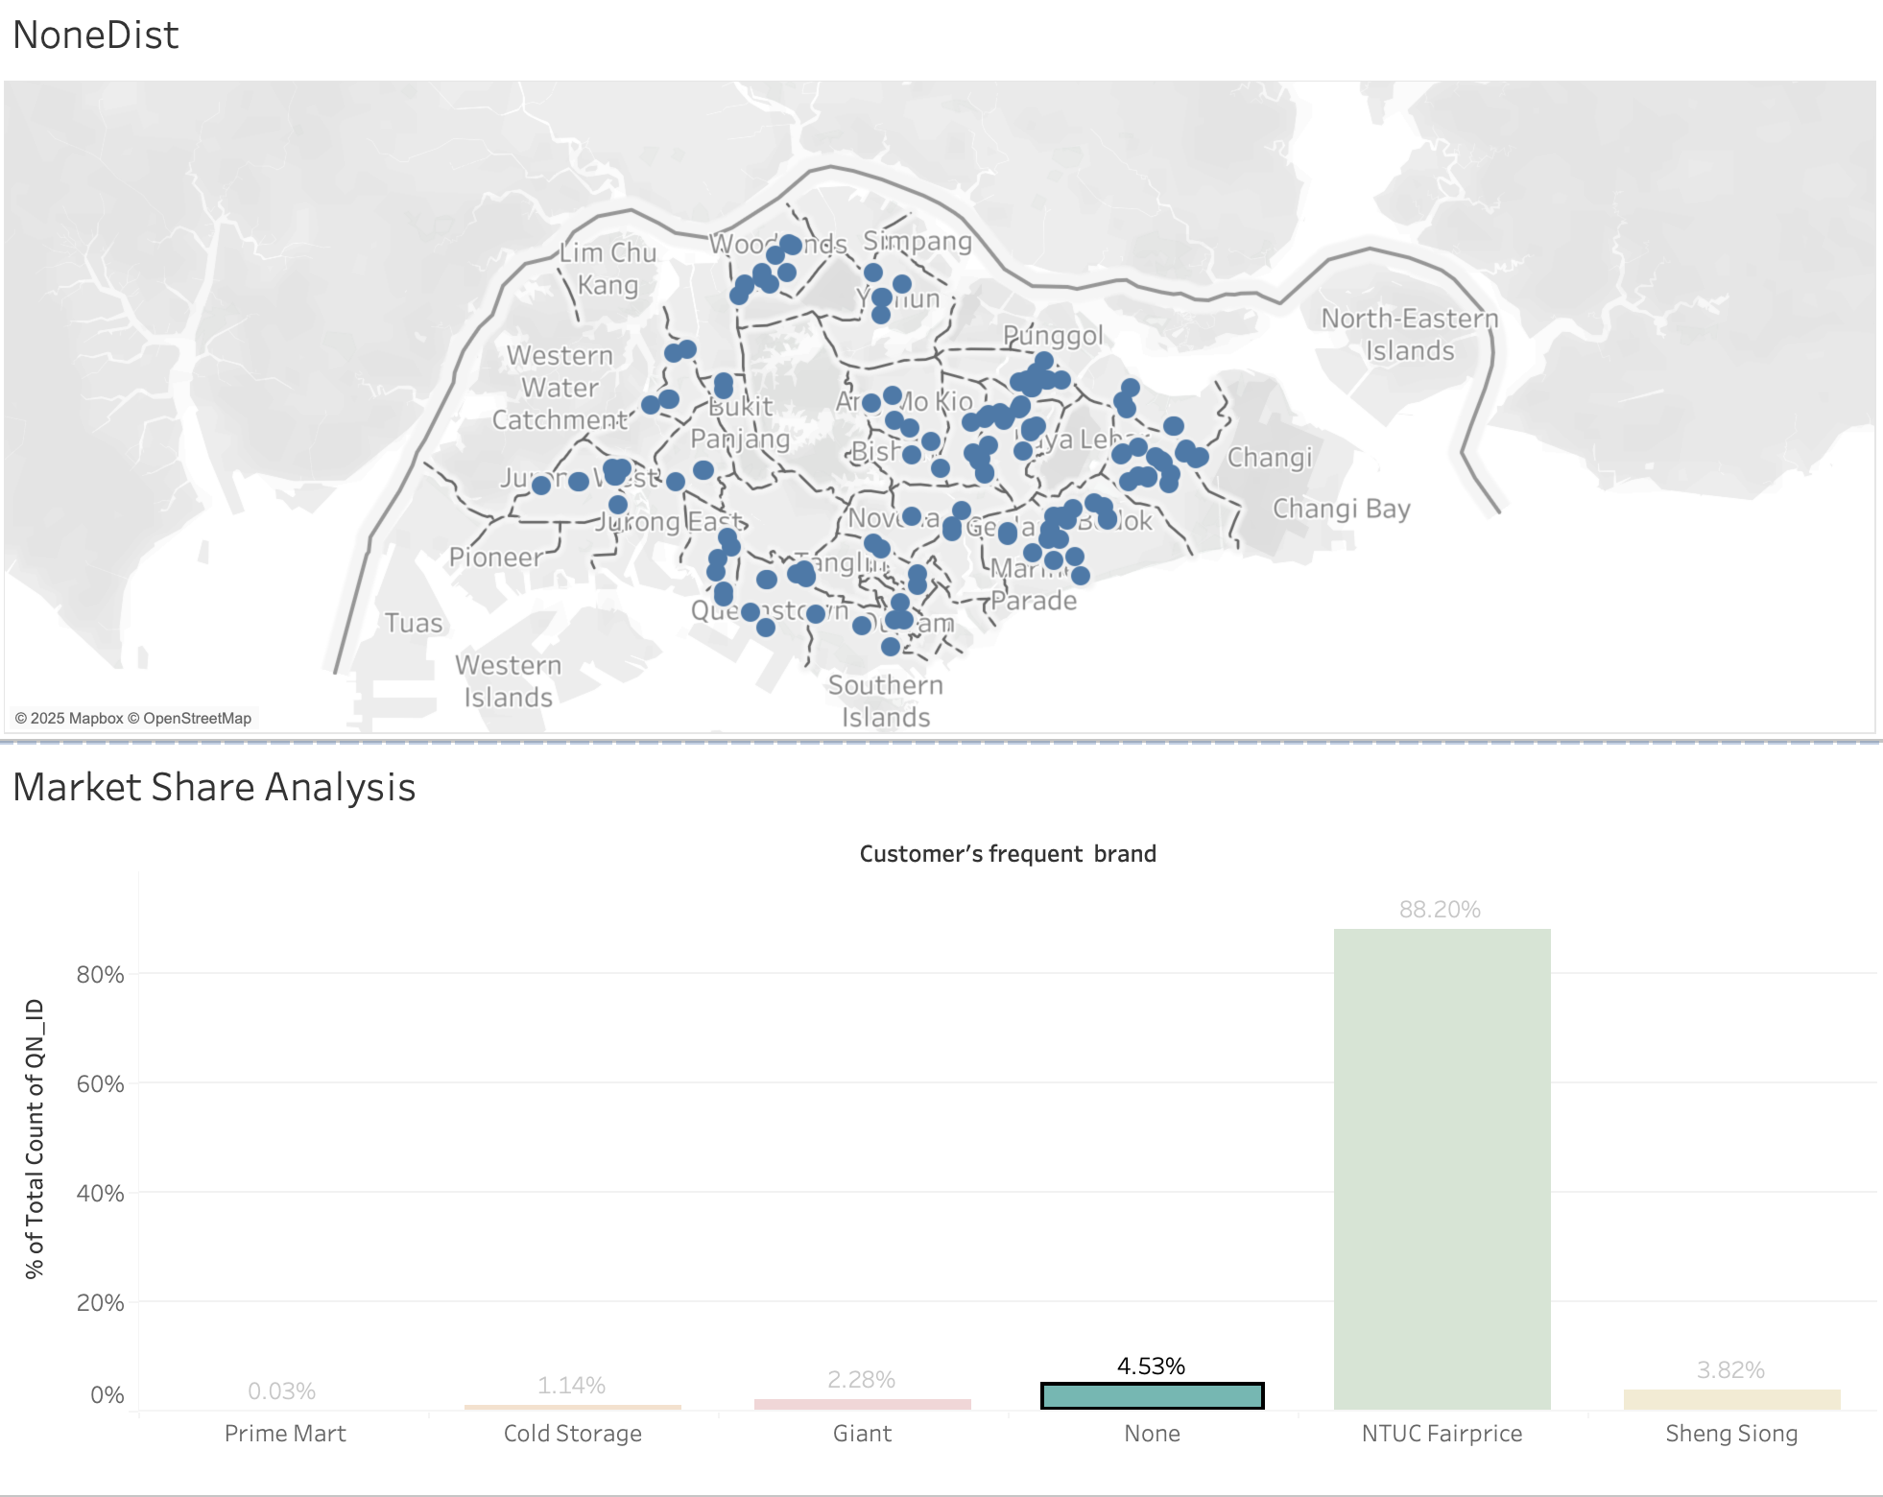
The None
Capturing the "None" Market Segment:
"None" refers to customers who have not chosen a specific brand yet, making up 4.53% of the market share, the second-largest after NTUC Fairprice.
These customers are uniformly distributed across Singapore and have an older average age across all income brackets, indicating that they belong to an elderly demographic.
To attract this segment, DFG should:
Increase store locations in key areas, as elderly customers are willing to travel for essentials but prefer nearby convenience.
Introduce targeted subscriptions and exclusive deals for elderly shoppers to build loyalty.
Ensure pricing and product offerings are adapted to the needs of elderly consumers, including accessibility-friendly store layouts and essential product availability.

Slide 19
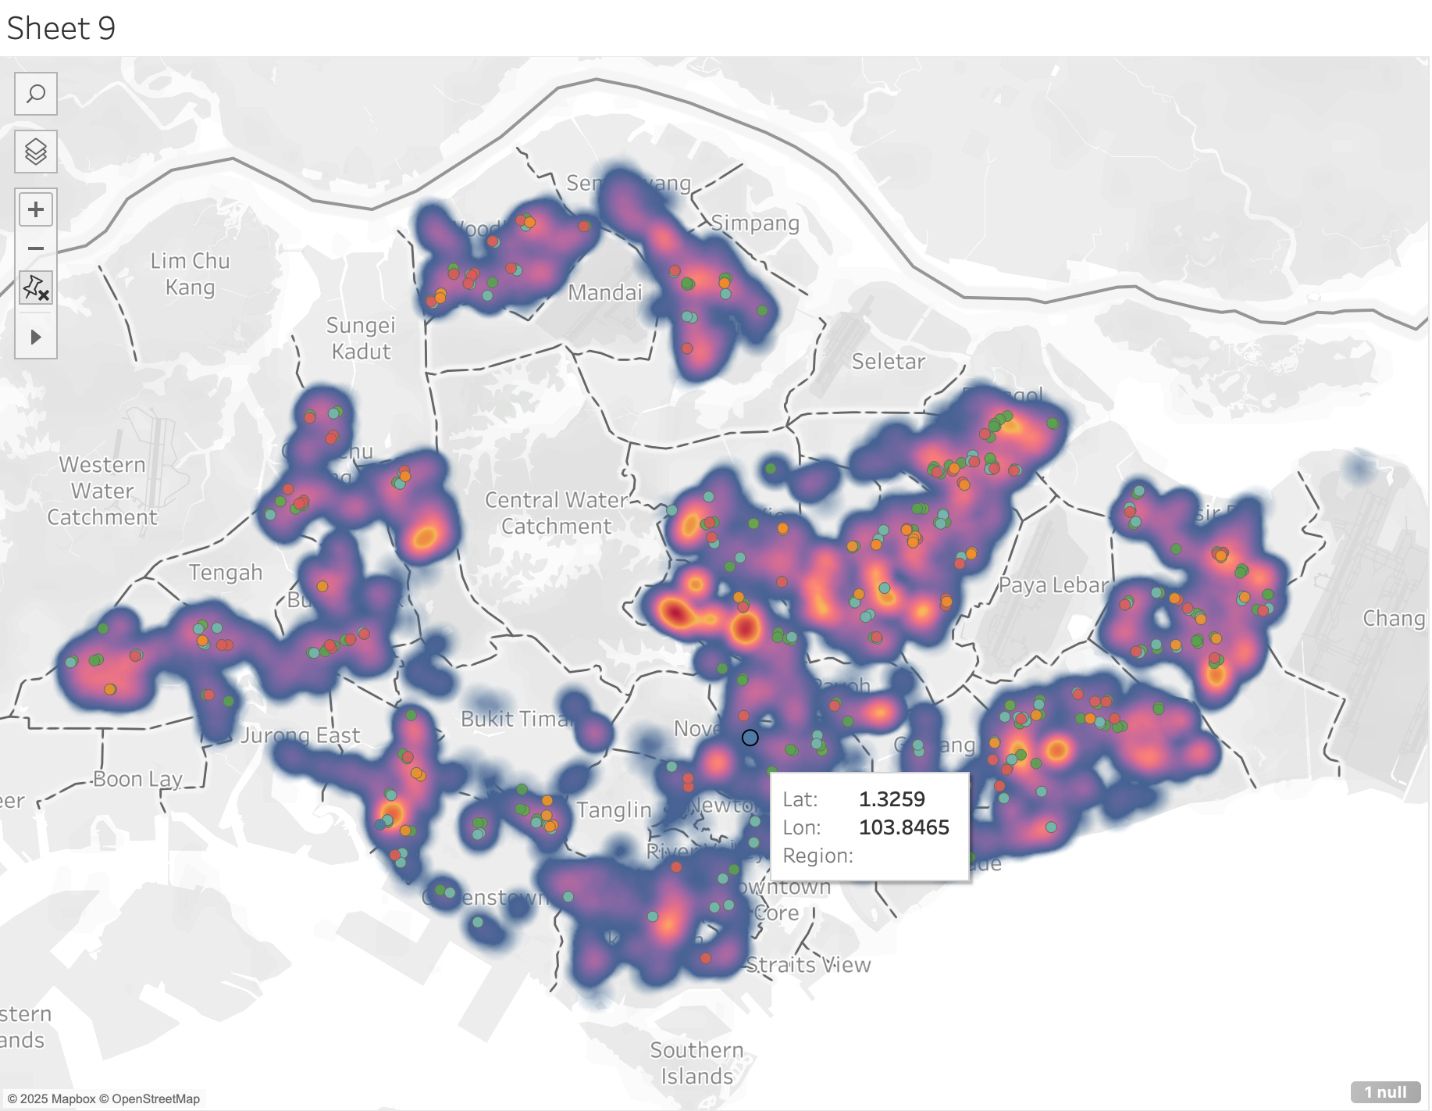
Store Locations and Customer Locations
The heatmap visualization highlights customer density and distribution across different regions, with warmer colors (red/yellow) indicating high customer concentration and cooler colors (blue/purple) showing lower activity.
Key Observations:
High customer density is observed in the East and North-East regions, despite fewer store locations in these areas.
The Central region has a higher store presence, but customer activity appears more dispersed, suggesting potential oversaturation.
The West region shows strong customer activity, though there are fewer stores compared to demand.
In the North region, there are some pockets of customer concentration, but overall, it has lower customer density.

Slide 20
Conclusion
Based on the analysis of customer distribution and store presence, DFG should adopt a targeted expansion and optimization strategy to maximize market reach and customer engagement.
Store Expansion & Optimization:
Increase store presence in high-demand areas (East & North-East) – These regions show strong customer density despite having fewer stores. Expanding here will capture untapped demand.
Expand in the West to retain and grow the customer base – The West has a strong customer base but relatively fewer stores. More locations could improve accessibility and convenience.
Reassess store concentration in the Central region – While there are many stores in this area, customer density is more dispersed. Optimizing store distribution could improve efficiency.
Explore potential in the North region – Though currently showing lower customer activity, strategic store placements and targeted promotions could tap into new customer segments.
By implementing these strategies, DFG can strengthen its market presence, increase customer engagement, and drive long-term growth.

Slide 21
Conclusion
Customer Engagement & Attraction Strategies:
Localized promotions and loyalty programs in areas with high competition to retain customers and encourage repeat visits.
Enhance delivery and online shopping options in regions where physical store expansion is not feasible.
Personalized marketing based on regional demographics to tailor product offerings and promotions to local preferences.
Improve in-store experience and product variety in key regions to differentiate from competitors and boost customer satisfaction.

Slide 22
THANK YOU

